Slide 1
HOSPITAL MANAGEMENT SYSTEM
Project Members:
Sneha P
Dharshiniaathi P
Soundarya S
Sindhuja K
Vishali P
Guided By
Prof. Indrakka Mali

Slide 2
Contents:
Introduction
Software Required
Working of Back-End
Work Flow
Annotations
APIs
Features of system
Conclusion

Slide 3
Introduction:
Hospital Management System is a enabling hospitals to manage information of doctor and patients.
Hospital Management System came about to assisting user to speed up their process like who are registered, search doctor/patients using id and update doctors/patient details and delete the records of patients.
Finally, HMS is a simple project about the record of the doctors and patients.

Slide 4
Software Requirement:
Language: Java
IDE: Spring Tool Suite
Client: Postman
Back-End: MySQL
Front-End: Angular,(Visual Studio Code for coding purpose)
Operating System: Windows 10 or 11

Slide 5
Working of Back-End:
Mainly Four packages used in this project. They are:
Entity
Controller
Repository
Service
Entity:
The entities are the persistence objects stores as a record in the database. In this entity, we have created the doctor, patient and error classes. Using this entity we have created two tables called doctor, patient.

Slide 6
Controller:
Controller class is responsible for processing incoming request, preparing the model and returning the view as a response.
Service:
Service Components are the class file which contains @Service annotation, to create a class with implements the doctor/patient service and write the business logic to store, update, retrieve and delete the data.
Repository:
Repository is used for managing the data. It directly connected with the database and then it can return to the repository and response to the service and it can return to the controller and then respond to the client.

Slide 7
Work Flow:
Client send a request to server for different options like inserting, fetching, update and delete a data.
When the client hit on request, request goes to the controller class and use respective url to take data.
Then control of url goes to the service class and conditions get executed.
For returning respond to client use same sequence to controller class.
Here, Repository class is used to interact with database using Hibernate Technology.

Slide 8
Annotations:
Annotations are used to provide supplemental information about a program. Annotation starts with @.
@Id: Used to declare attribute as primary key.
@GeneratedValue: Used to generate value automatically when user insert new record in the table.
@JsonIgnore: Used to ignore the logical property used in serialization and serialization.
@Entity: Used to mark this class as an Entity bean.
@PathVariable: Used to extract the value of the template variables and assign their values

Slide 9
@OnetoMany: Used to create a one to many relationship between the subject id and student entities.
@Cascadetype.All: ensure that all persistence events such as persist, refresh, merge and remove that occur on the parent will be passed to the child.
@override: informs the compiler that elements is meant to override an element declared in superclass.
@RestController: Used at the class level and allows the class to handle the requests made by the client.
@Autowired: Enables you to inject the object dependency implicitly.
@Repository: Used to in repository class.
@Service: Used to mark the class as a service provider.

Slide 10
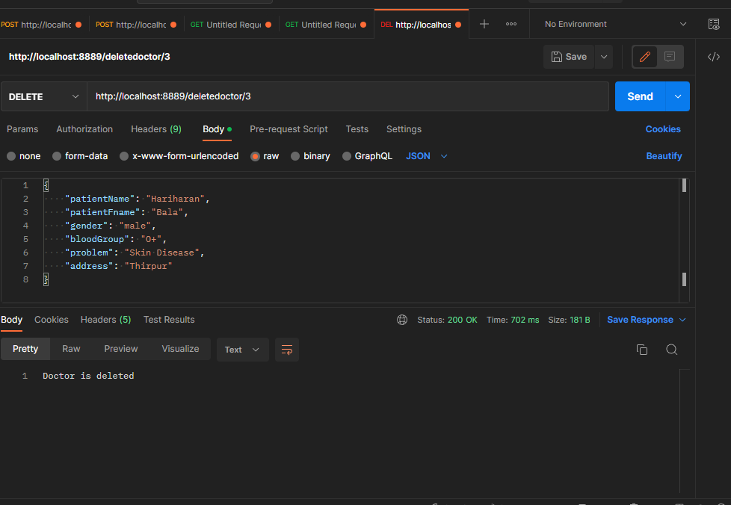
APPLICATION PROGRAMMING INTERFACE API
API under direct to do all: Directly can access all doctor/patient details using this url.

Slide 11
Doctor URL
@PostMapping/Doctors: This annotation is used to insert the doctor’s data using the Http request.
http://localhost:8889/doctors- insert the data in the doctor field.
@GetMapping/Doctores: Used to when getting the data using Http get request.
http://localhost:8889/getAllDoctor- Used to get all doctor data
http://localhost:8889/getbydoctor/1- Used to get doctor by using Id No.
@PutMapping: Used to update the data using Http put request.
http://localhost:8889/updatedoctor/1- Used to update any information about doctor.

Slide 12
@DeleteMapping: Used to delete the data using Http delete request.
http://localhost:8889/deletedoctor/1- Delete the particular doctor information using id no.
Patients URL:
@PostMapping/Patients: This annotation is used to insert the patients data using the Http request.
http://localhost:portno/patients- insert the data in the patient field.
@GetMapping/Patients: Used to when getting the data using Http get request.
http://localhost:8889/getAllpatients- Used to get all patients data
http://localhost:8889/getbypatient/1- Used to get patients by using Id No.

Slide 13
@PutMapping: Used to update the data using Http put request.
http://localhost:8889/updatepatient/1- Used to update any information about patients.
@DeleteMapping: Used to delete the data using Http delete request.
http://localhost:8889/deletepatient/1- Delete the particular patients information using id no.

Slide 14
FRONT END:
To connect the spring boot program with vs code program using @cross origin annotation.
Command used:
The component command – ng g c componentname
The class command-ng g class classname
The service command-ng g s servicename
To run the project-ng serve --open

Slide 15
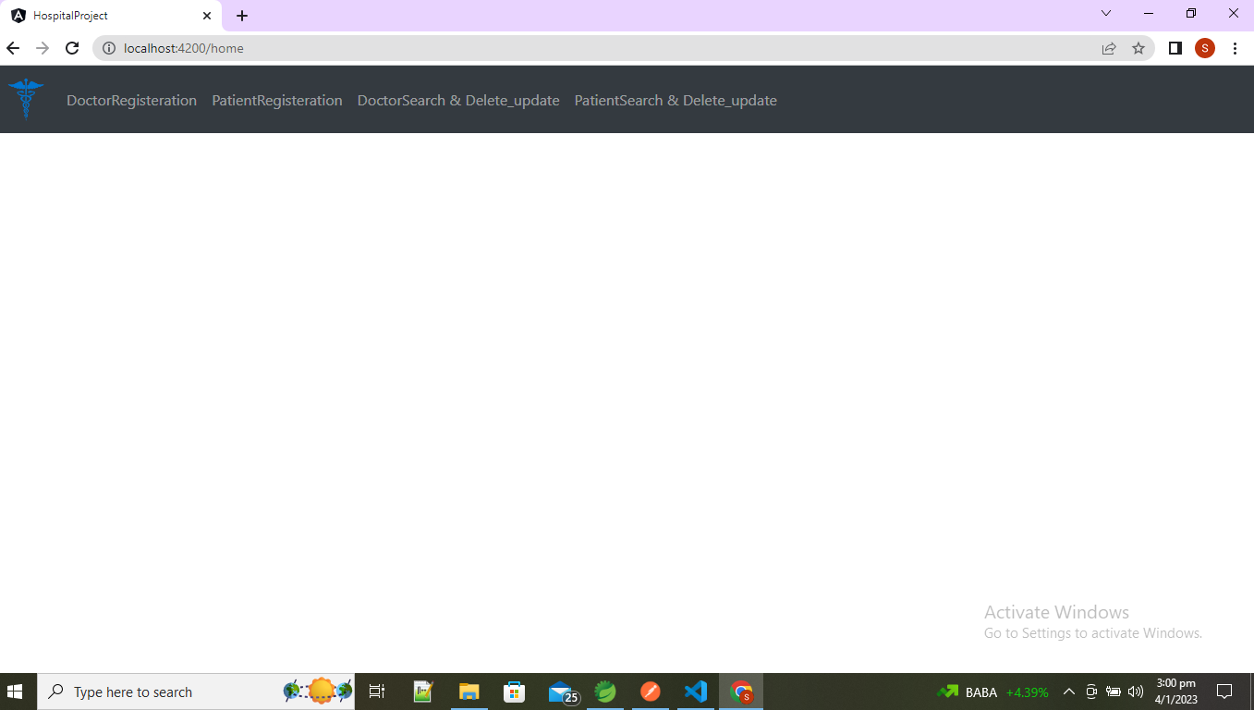
HOME PAGE

Slide 16
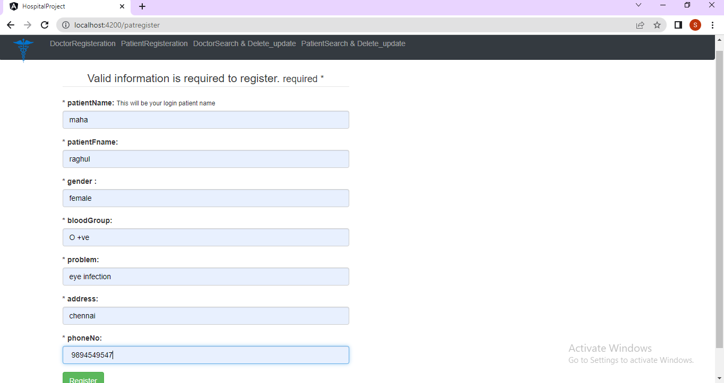
REGISTER PATIENT PAGE

Slide 17
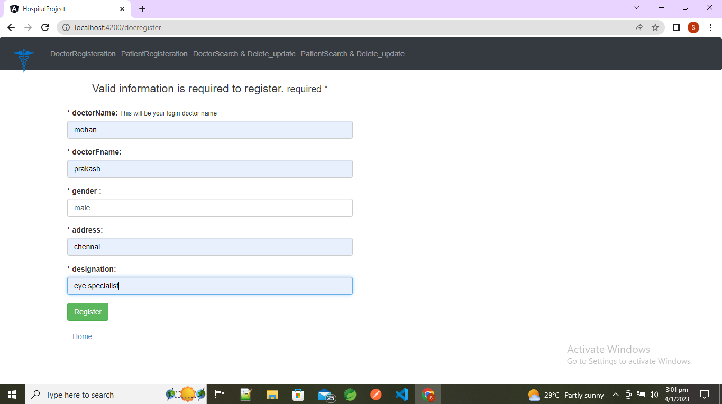
DOCTOR REGISTER PAGE

Slide 18
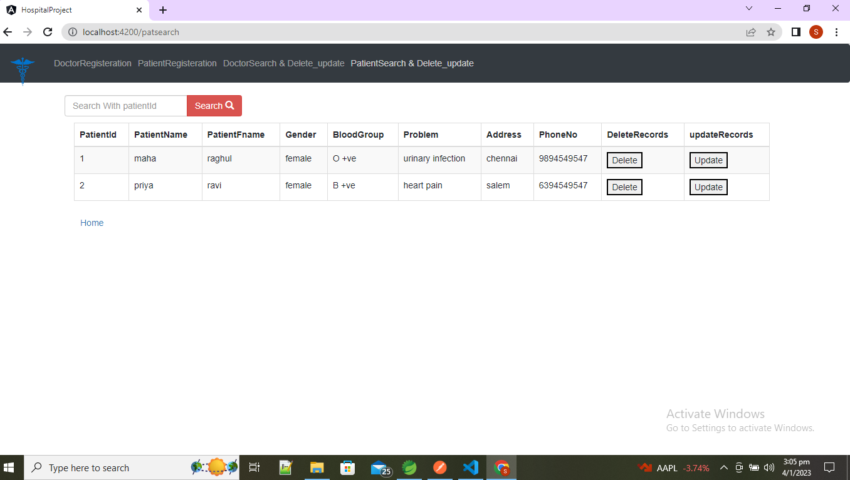
SEARCH PAGE

Slide 19
CONCLUSION:
The project entitled as Hospital Management System is the system that deals with the issues related to a particular hospital.
This project is successfully implemented with all the features mentioned in system requirements specification.
So this serves the right purpose in achieving the desired requirements of both the communities.

